Slide 1
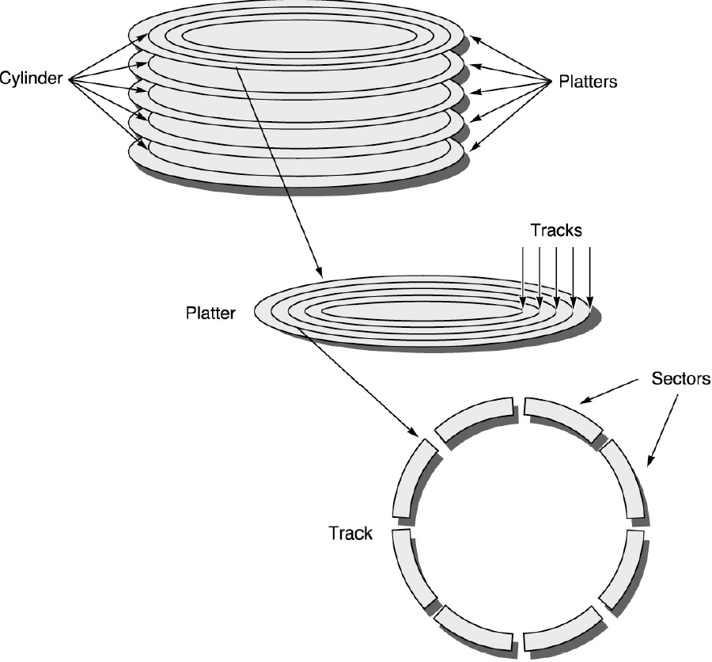
Storage Systems
Types of Storage Devices: magnetic disks, magnetic tapes, automated tape libraries, CDs, DVDs, and flash memories.
  Magnetic disks: long-term, nonvolatile storage for files, and a level of the memory hierarchy below main memory.
Characteristics (as of 2000) | Seagate Cheetah | IBM Travelstar | IBM GB Microdrive
Disk diameter (inches) | 3.5 | 2.5 | 1.0
Formatted data capacity | 73.4 GB | 32.0 GB | 1.0 GB
Cylinders | 14,100 | 21,664 | 7,167
Disks | 12 | 4 | 1
Recording surfaces (heads) | 24 | 8 | 2
Bytes per sector | 512-4,096 | 512 | 512
Avg. sectors/track (512B) | 424 | 360 | 140
Max. areal density (Gb/in²) | 6.0 | 14.0 | 15.2
Rotation speed (RPM) | 10,033 | 5,411 | 3,600
Avg. random seek (r/w) (ms) | 5.6/6.2 | 12.0 | 12.0
Min. seek (r/w) (ms) | 0.6/0.9 | 2.5 | 1.0
Max. seek (r/w) (ms) | 14.0/15.0 | 23.0 | 19.0
Data transfer rate (MB/sec) | 27-40 | 11-21 | 2.6-4.2

Slide 2
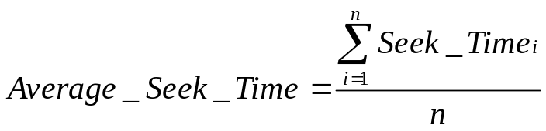
Storage Systems
Types of Storage Devices: magnetic disks, magnetic tapes, automated tape libraries, CDs, DVDs, and flash memories.
  Magnetic disks: long-term, nonvolatile storage for files, and a level of the memory hierarchy below main memory.
    Average seek time is defined to be:
    Where n is the number of all possible seeks.
    Average rotation time is defined to be halfway round the disk;
    Transfer time is the time it takes to transfer a block of bits, typically a sector, under read/write head, which is a function of the block size, disk size, rotation speed, recording density of the track, and the speed of the electronics connecting the disk to the computer.
    Read ahead is used to amortize the long access by reading more than what is simply requested. A buffer of a few MB is used to store the prefetched data that assumes possible spatial locality.
    Areal density is a measure of recording density in terms of bits per square inch:

Slide 3
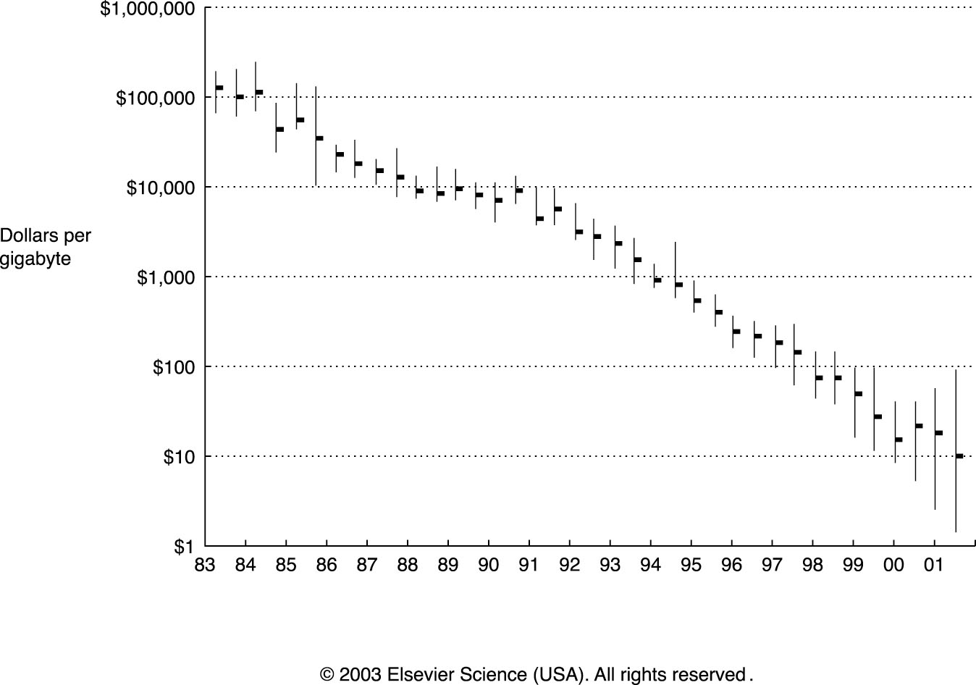
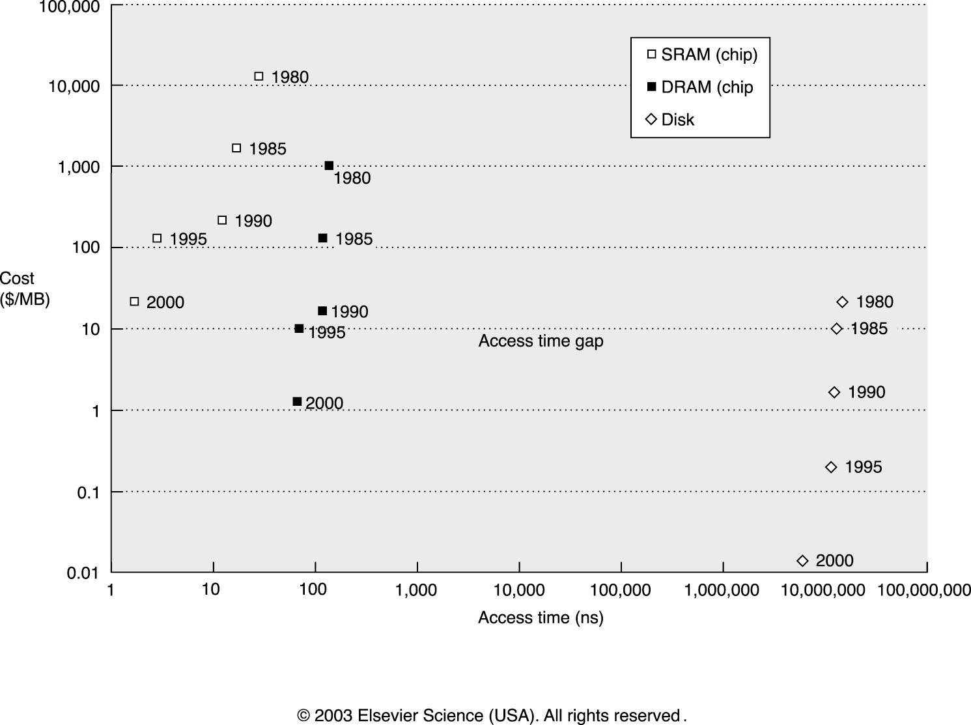
Storage Systems
Types of Storage Devices: magnetic disks, magnetic tapes, automated tape libraries, CDs, DVDs, and flash memories.
  Magnetic disks: long-term, nonvolatile storage for files, and a level of the memory hierarchy below main memory.
    Areal density increased at 29%/yr before 1988, 60%/yr from 1988-1996, and 100%/yr since 1996; while cost of disks is dropping steadily.

Slide 4
Storage Systems
Types of Storage Devices: magnetic disks, magnetic tapes, automated tape libraries, CDs, DVDs, and flash memories.
  Optical Disks
    CDs (optical compact disks) and its successor DVDs (digital versatile discs) are removable and inexpensive to manufacture. CD-RWs and DVD-RWs are gradually becoming affordable and popular.
    Writable optical disks may have the potential to compete with new technologies for archival storage, as tape also improves much more slowly than disks.
  Magnetic Tapes
    Similar technology as disks and followed the same density improvement rate
    Their geometries determines the inherent cost-performance difference between disks and tapes: random access vs. sequential access; limited storage area vs. “unlimited” length
    Helical scan, a technique that solves the problem of breaking or jamming while spinning, records the information on a diagonal to the tape reader that spins much faster than the tape is moving, increasing density by a factor of 20 to 50 (e.g., used for low-cost VCRs and camcorders)
    The cost advantage of tapes over disks is eroding fast: by 2001 a 40GB IDE disk cost about the same as a 40GB tape!

Slide 5
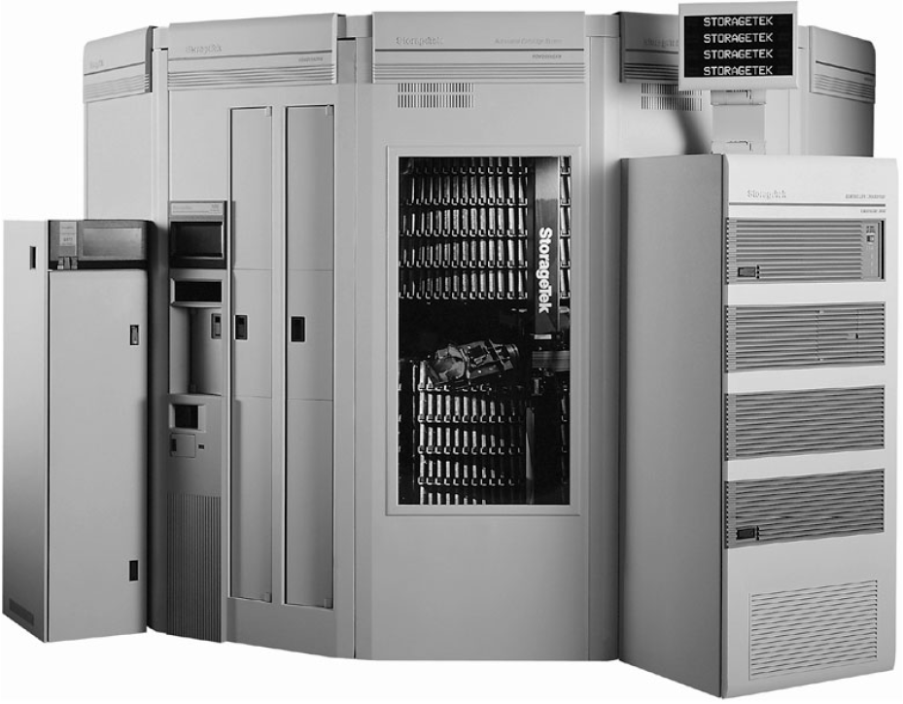
Storage Systems
Types of Storage Devices: magnetic disks, magnetic tapes, automated tape libraries, CDs, DVDs, and flash memories.
  Automated Tape Libraries
    Inexpensive robots automatically load and store tapes, offering a new level of storage hierarchy: e.g., STC PowderHorn loads up to 6000 tapes (300 TB, Library of Congress has about 30TB of text).

Slide 6
Storage Systems
Types of Storage Devices: magnetic disks, magnetic tapes, automated tape libraries, CDs, DVDs, and flash memories.
  Flash Memory
    Like EEPROM (electrically erasable and programmable read-only memory), it is written by inducing the tunneling of charge from transistor gain to a floating gate. The floating gate acts as a potential well that stores the charge, and the charge cannot move from there without applying an external force. Flash memory restricts writes to multikilobyte blocks, increasing memory capacity per chip by reducing area dedicated to control
    A cost-effective substitute for magnetic recording device in embedded devices, consumes much less power (50 milliwatts) than disks, and offers read access time comparable to DRAMs.
    Also used as rewritable ROM in embedded systems
    Example: compare the time to read and write a 64KB block to Flash memory and magnetic disk. For Flash, assume it takes 65 ns to read 1 byte, 1.5 μs to write 1 byte, and 5 ms to erase 4 KB. For disk, use the parameters of the Microdrive in Figure 7.2. Assume the measured seek time is one-third of the calculated average, the controller overhead is 0.1 ms, and the data are stored in the outer tracks, giving it the fastest transfer rate.
      Flash memory is 6 times faster than disk for reading 64 KB, but 6 times slower than disk for writing 64 KB (assuming disk already in operation).

Slide 7
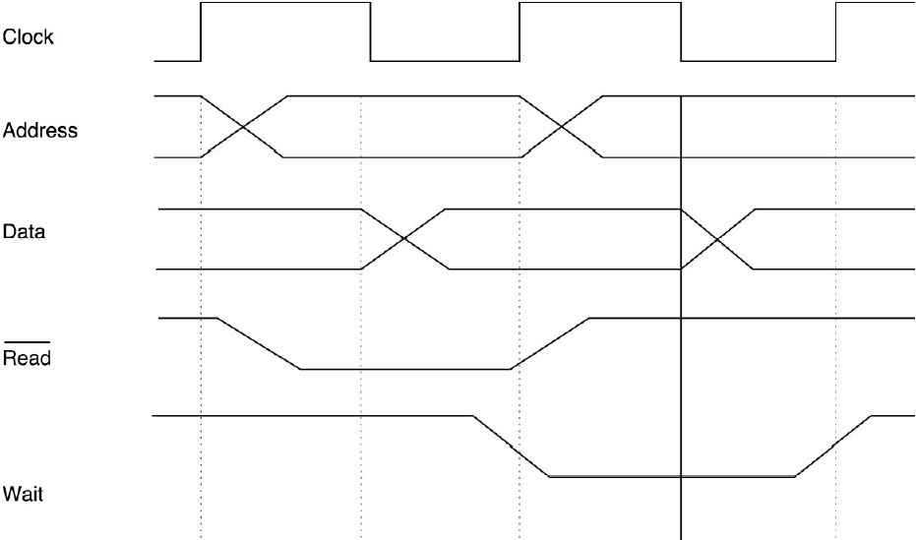
Storage Systems
Buses – Connecting I/O Devices to CPU/Memory
  A shared communication link between the subsystems of a computer
  Major disadvantage: a potential communication bottleneck
  Buses are increasingly being replaced by networks and switches, e.g., storage area networks (SANs)
  A typical bus transaction includes two parts: sending the address and receiving or sending the data.

Slide 8
Storage Systems
Buses – Connecting I/O Devices to CPU/Memory
  Bus Design Decisions Decisions and Main Options
  Split transaction, also know as pipeline bus or pended bus, divides bus events into requests and replies and allows multiple masters share the bus, thus availing more bandwidth
  Synchronous buses are inexpensive and faster because of simple control; However, they cannot be very long due to clock skew problems and everything on the bus must run at the same clock rate
  An asynchronous bus is self-timed and operates on handshaking protocols between sender and receiver.
Option | High Performance | Low Cost
Bus width | Separate address and data lines | Multiplex address and data lines
Data width | Wider is faster (e.g., 64 bits) | Narrower is cheaper (e.g., 8 bits)
Transfer size | Multiple words have less bus overhead | Single-word transfer is simpler
Bus master | Multiple masters (requires arbitration) | Single master (no arbitration)
Split transaction? Split transaction? | Yes—separate request and reply packets get higher bandwidth | No—continuous connection is cheaper and has lower latency
Clocking | Synchronous | Asynchronous Asynchronous

Slide 9
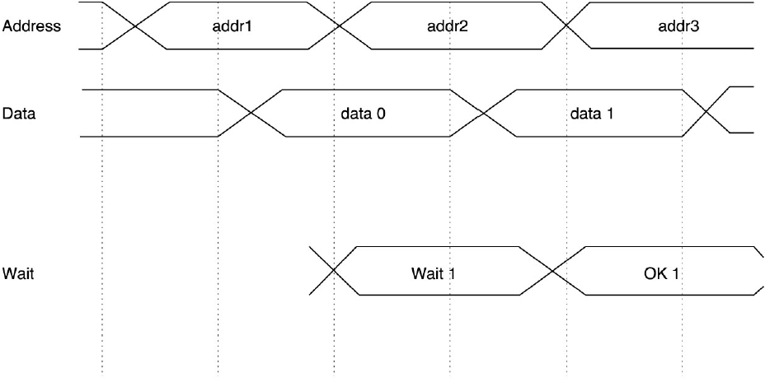
Storage Systems
Buses – Connecting I/O Devices to CPU/Memory
  A Split Transaction Bus

Slide 10
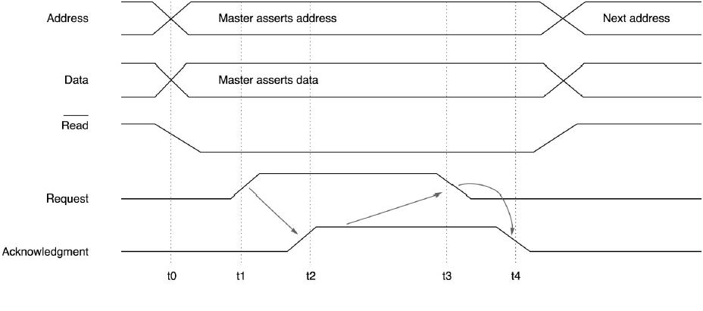
Storage Systems
Buses – Connecting I/O Devices to CPU/Memory
  A Master Performs A Write on An Asynchronous Bus

Slide 11
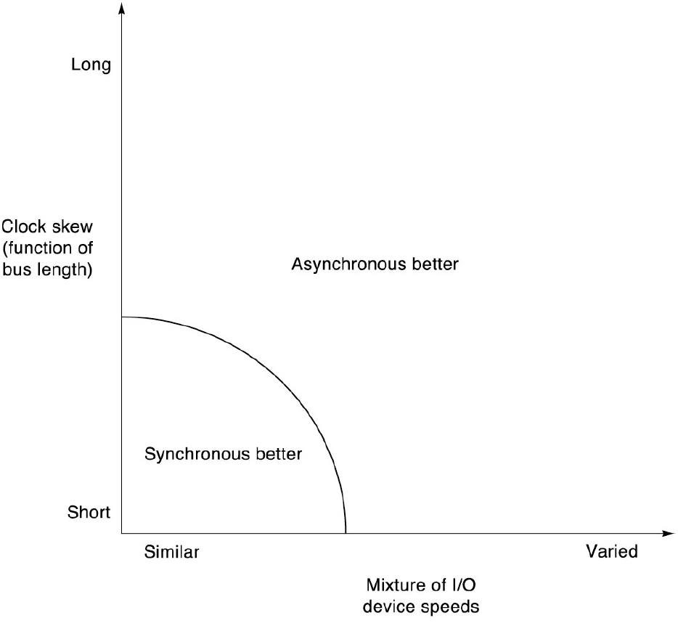
Storage Systems
Buses – Connecting I/O Devices to CPU/Memory
  Preferred Bus Type as A Function of Length/Clock Skew And Variation in I/O Device Speed

Slide 12
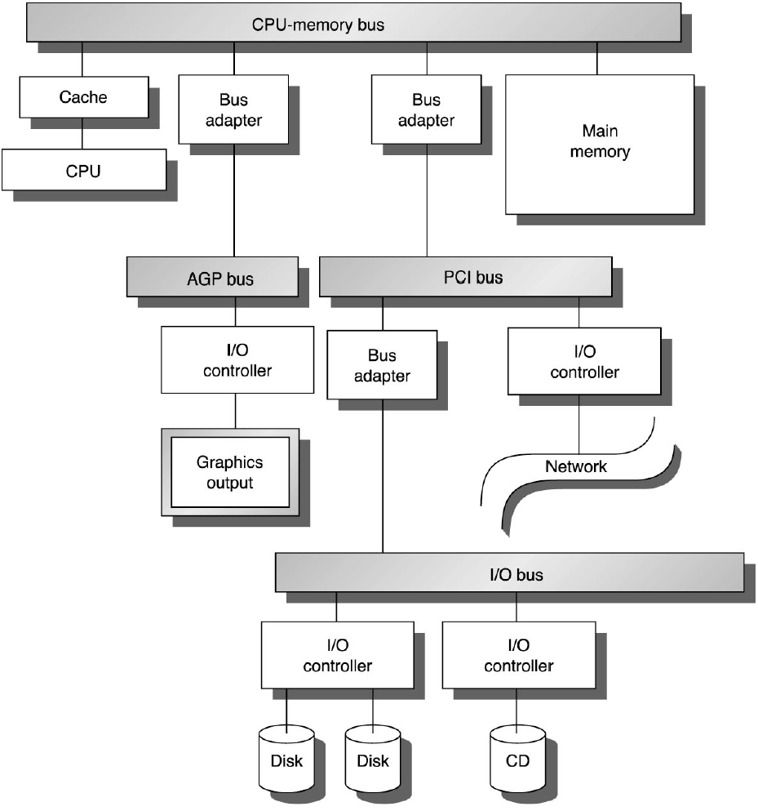
Storage Systems
Buses – Connecting I/O Devices to CPU/Memory
  Interfacing Storage Devices to the CPU
Memory-Mapped I/O (common)
Dedicated I/O opcodes (e.g., Intel 80x86, IBM 370)
Registers in I/O devices to provide status and control information
CPU polling vs. interrupt-driven
Direct memory access (DMA)
I/O processorss (or Channel controllers)

